Slide 1

Search engine based on permuterm index
Information Retrieval V.Venkatesh
J.S.Sunil
K.Upendra
K.Sai prasanna
N.Prudhvi

Slide 2

Introduction
• A user is uncertain about the spelling of a query term
– S*dney uncertain about Sydney or Sidney
• A user is aware of multiple variants of spelling a term and (consciously) seeks documents containing any of the variants
– Color versus colour
• A user searches documents containing variants of a term that would be caught by stemming, but is unsure whether the search engine conducts stemming
– “judicia*” judicial versus judiciary
When do we use wildcard queries?

Slide 3
Introduction
We’ll express given wild card query as Boolean on special constructed index to answer to user’s query
Then we match them with indexes created and discarding vocabulary terms that do not match query from specially constructed index.
Handling These Wildcard Queries

Slide 4
Introduction
One of the efficient ways of handling these wild card queries.
Use a special symbol $ to mark the end of a term
A permuterm index contains various rotations of each term augmented with $ all linked to the original vocabulary term
The permuterm vocabulary: the set of rotated terms in the permuterm index
Permuterm Indexes

Slide 5
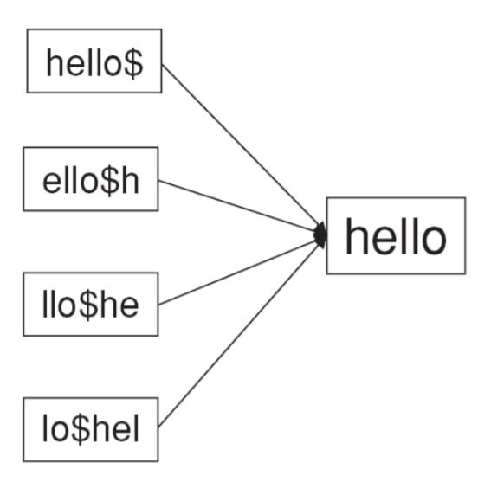
An example of permuterm rotations
Suppose consider an example term hello
We mark the end of the term by a ‘$’ sign
This helps us in identifying where the original term ended.
hello$ ->ello$h -> llo$he -> lo$hel -> o$hell -> $hello
These are all the possible permutations of the term.

Slide 6
Introduction
Rotate a wildcard query so that the * symbol appears at the end of the string
- Example : Rotate I*TS to TS$I*
• Look up the string in the permuterm index
- Find Terms TS$III and TS$II -> IIITS and IITS are the the possible answers
Query Answering – One * Symbol

Slide 7
Introduction
• Example query: q = fi*mo*er
• Conduct query Q = er$fi
• Check each term returned from Q against q, only search the inverted index for those terms satisfying q
• Cost: the permuterm index is quite large since it contains all rotations of each term
– On average 10 times for English documents
Query Answering – Multiple *’s

Slide 8
Introduction
For query q = f*mo*er
Append a $ in the end and rotate until a * comes to the end
Now, for er$f*mo* remove the trailing * and split based on * and generate two strings Q1 and Q2
we can run queries Q1 = er$f and Q2=mo and obtain the intersection of the answers
This way we can handle multiple queries
Query Answering – Multiple *’s

Slide 9
THANK YOU
FIRST UP CONSULTANTS
Deadline Hitters
Js.Sunil – S20160010033
K.Upendra – S20160010038
k.Sai Prasanna – S20160010047
N.Prudhvi – S20160010057

